Slide 1



Clinical Management of PrEP Users
Who Test Positive for HIV
Jean-Michel Molina, MD
University of Paris and Saint-Louis Hospital, INSERM U944, France
HIV testing and Management in the Era of PrEP

Slide 2
Disclosures
Advisory boards: Gilead, Merck, ViiV, Sanofi
Research grants: Gilead
Notes:
2

Slide 3
Multiple Causes of HIV Positive Tests in PrEP Users
Rare events which need thorough investigations
PrEP discontinuation or low adherence
HIV-infection before PrEP initiation
Breakthrough infection with a resistant virus
Breakthrough infection with a susceptible virus
False-positive HIV test

Slide 4

HIV-Infections among MSM Enrolled in the EPIC Study in NSW
3700 recruited from 03/01/2016 to 10/31/2016
and dispensed PrEP at baseline
2 new HIV infections:
1 was dispensed but never commenced PrEP
1 discontinued PrEP months prior to infection
Incidence rate:
0.048/100 person-years
(95%CI 0.012-0.195)
62 No HIV follow-up test (1.7%)
49 Withdrawal from study
- 20 no longer at risk of HIV infection
- 8 side effects
- 4 moved out of juridisction
- 6 can no longer attend
- 2 tired of taking pills every day
- 3 eGFR dropped below 60 ml/mn
- 6 others
3069 (83%) with visit M12 or later
4,100 PY by 10/31/2017 for HIV incidence
Grulich A. et al. Lancet HIV 2018
Notes:
EPIC a prospective cohort study

Slide 5
iPrEx OLE: HIV Incidence According to
TFV-DP Levels in DBS
TFV-DP in DBS fmol/punch | Est. dosing (Tablets/wk) | % of FU | HIV incidence /100PY | 95% CI
<2.5 | None | 26% | 4.7 | 2.8 - 7.2
2.5 to <350 | <2 | 27% | 2.2 | 1.1 - 4.1
≥350 to <700 | 2 to 3 | 12% | 0.6 | 0.0 - 2.5
≥700 to 1249 | 4 to 6 | 22% | 0 | 0.0 - 0.6
≥1250 | Daily | 5% | 0 | 0.0 - 1.1
*Tenofovir-diphosphate (TFV-DP) was quantified in dried blood spots (DBS)
Drug concentrations strongly associated with HIV incidence
No HIV-infection detected with estimated use > 4 tablets per week
Grant et al Lancet ID 2014

Slide 6
Multiple Causes of HIV Positive Tests in PrEP Users
Rare events which need thorough investigations
PrEP discontinuation or low adherence
HIV-infection before PrEP initiation
Breakthrough infection with a resistant virus
Breakthrough infection with a susceptible virus
False-positive HIV test

Slide 7

Performance of HIV Screening Tests in a PrEP Trial
Retrospective analysis of stored sera from 28 HIV-infections during the trial
WB Assay | 4th G Ag/Ab Architect° | Rapid POC Vikia° | Autotest° AAZ | Ag/Ab POC Alere°
Complete (n=7) (> 6 bands) | 7 (100%) | 7 (100%) | 7 (100%) | 6/6 (100%)
Incomplete (n=8) (1-6 bands) | 8 (100%) | 6 (75%) | 7 (88%) | 8 (100%)
Negative (n=13) (No antibodies) | 11 (85%) | 2 (15%) | 0 (0%) | 7 (54%)
Overall (n=28) | 26 (83%) | 15 (54%) | (50%) | 21 (78%)
Two patients with negative 4G at screen were diagnosed one month later with a positive 4th G assay with plasma HIV RNA at screen: 110 and 450 c/mL
Delaugerre C. et al JID 2017

Slide 8
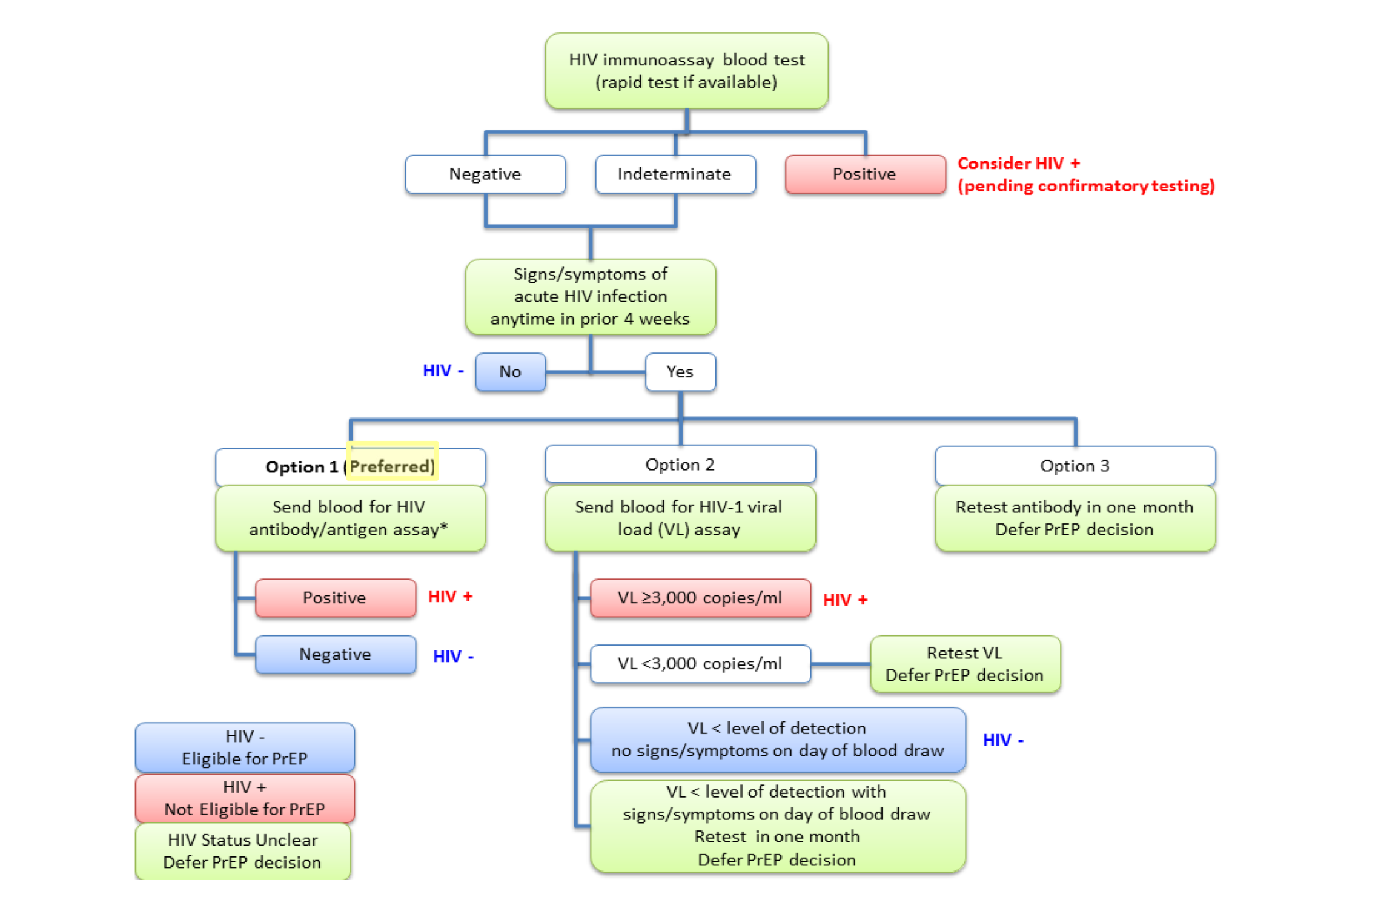
Determination of HIV Status for PrEP Provision :
CDC and IAS-USA Guidelines
PrEP users are at high risk of HIV-infection and a visit one month post-PrEP initiation will diagnose missed
acute HIV-infection at PrEP initiation
https://www.cdc.gov/hivpdf/guidelines/PrEPguidelines2017.pdf
Saag M. et al JAMA 2018
Notes:
In France, combined test, PCR if doubt, and repeat combinded test one month later

Slide 9
Multiple Causes of HIV Positive Tests in PrEP Users
Rare events which need thorough investigations
PrEP discontinuation or low adherence
HIV-infection before PrEP initiation
Breakthrough infection with a resistant virus
Breakthrough infection with a susceptible virus
False-positive HIV test

Slide 10
Acquisition of TDF/FTC Resistant HIV
Despite High PrEP Adherence
Cases | Time since PrEP Initiation | NRTI RAMs | Drug Concentration*
Knox et al. NEJM 2017 | 24 months | M184V, K70R, Y215E, M41L | DBS, plasma
Markowitz et al. JAIDS 2017 | 5 months | M184V, K65R | Hair, DBS
Thaden et al. AIDS 2018 | 14 months | M184V, K65R, K70T | Hair, plasma
Colby et al. CID 2018 | 8 weeks | M184V | Hair, plasma
Cohen et al. Lancet HIV 2019 | 13 months | M184V, L74V | Hair, DBS, plasma
* DBS and hair levels consistent with daily dosing in prior 6 weeks
Adapted from Cohen S. et al Lancet HIV 2019
Notes:
DBS and hair levels consistent with daily dosing in previous 6 weeks at least
Markowitz: 2-4 weeks delay between prescription and PrEP initiation +++
Colby: no plasma viral load at the baseleine visit and only 3rd G Ab test was negative+++
Thaden: first PrEP visit 13 months before infection, was given 11 refills, asked to come back after 1 and 6 months but no interim visits, self reported discontinuation of PrEP for 3 months, 8 months before infection, good PrEP adherence in the three month prior to HIV diagnosis, with flu-like symptoms one month before infection

Slide 11

Effect of TDF/FTC against Rectal Challenges with R-SHIV and M184V
% Uninfected Macaques
100
Oral TDF/FTC (-72h, +2h)
(n = 5)
75
100% Efficacy
50
% Uninfected animals
25
Untreated Controls (n = 5)
0
0
2
4
6
8
10
12
14
Number of weekly rectal SHIV M184V exposures
Cong ME. et al. J. Virol 2011
Notes:
11
sgsfdgsfd
M184V mutation in SHIV introduced by site directed mutagenesis resulted in >100 fold resistance to FTC and increased susceptibility 3 fold to TDF
All five untreated animals, readily infected with a similar number of challenges, but peak viremia lower (1 log) to that of infection with WT virus
So PrEP with TDF/FTC retains activity against highly resistant isolate

Slide 12
Selection of Drug Resistance in Clinical Trials with TDF/FTC for PrEP
RAMs assessed: K65R (TDF, FTC), K70E (TDF) or M184V/I (FTC)
Trial | No with TDF/FTC | Acute Infection At enrollment Nb resistance / total | Seroconverted after enrollment Nb resistance / total
iPrEx | 1224 | 2/2 | 0/48
Partners PrEP | 1579 | 2/4 | 0/21
TDF2 | 611 | 1/1 | 0/9
FEM-PrEP | 1062 | 0/1 | 4/33
VOICE | 1003 | 2/9 | 1/61
PROUD | 275 | 2/3 | 0/2
IPERGAY | 199 | 0/2 | 0/2
TOTAL | 5953 | 9/22 (41%) | 5/176 (< 3%)
Resistance when seroconverting in the TDF/FTC arm: M184V/I (1 K65R)
Adapted from Parikh and Mellors, Curr Opin HIV AIDS 2016
Notes:
Acutes
iPrEX 2/2: one patient in the placebo arm had MDR with M184V, T215Y, K103N
With deep sequencing, no mutation M184V, K70E, or K65R in the TDF/FTC arm.
K65R developed in one Partners PrEP participants; 7 months after vseroconversion: M184V/I occurred first, then K65R

Slide 13

Effect of TDF/FTC against Rectal Challenges with R-SHIV and K65R
% Uninfected Macaques
100
Oral TDF/FTC (-72h, +2h)
(n = 6)
75
33% Efficacy
50
% Uninfected animals
25
Untreated Controls (n = 6)
0
0
2
4
6
8
10
12
14
Number of weekly rectal SHIV K65R exposures
Cong ME. et al. JID 2013
Notes:
13
sgsfdgsfd
K65R mutation introduced by site directed mutagenesis resulted, like HIV, in moderate resistance to FTC 11-fold and TDF 6 fold
All six untreated animals, readily infected with a similar number of challenges, there was a delay infection in those receiving TDF/FTC , with similar peak viremia
Transmissibility was lower than wild-type , with need to increase the infecting dose 10 fold to infect macaques
Only partial protection with this mutant virus

Slide 14
Rates of Transmitted HIV-1 Resistance to TDF/FTC among Treatment Naïve Patients
References | Nb Pts | Years | M184V/I (Nb, %) | K65R (Nb, %) | K70E (Nb, %)
Rhee et al. CID 2019 | 4,253 | 2003-2016 | 20 (0.5%) | 2 (0.05%) | 0 (0%)
Banez Ocfemia CROI 2014 | 10,894 | 2008-2011 | 44 (0.4%) | 3 (0.03%) | 4 (0.04%)
Gupta et al. Lancet ID 2017 | 56,044 | 2014-2016 | 292 (0.5%) | (0.1%) | NA
Chan et al. JIAS 2012 | 19,823 | 1999-2008 | NA | 20 (0.1%) | 3 (0.015%)
Olson et al. AIDS 2018 | 4,717 | 1996-2012 | 34 (0.7%) | 8 (0.2%) | 0 (0%)
NA: not available
Notes:
Treatment naive individuals
Rhee: no increase in NRTI RAM over time +++
Banez: among MSM
Chan : treatment naive, USA, Europe, Africa, Asia
Oslon ; Cascade seroconversion cohort in Europe
Gupta systematic review: no increase in prevalence of NRTI-R over time

Slide 15
Multiple Causes of HIV Positive Tests in PrEP Users
Rare events which need thorough investigations
PrEP discontinuation or low adherence
HIV-infection before PrEP initiation
Breakthrough infection with a resistant virus
Breakthrough infection with a susceptible virus
False-positive HIV test

Slide 16
Acquisition of TDF/FTC Suceptible HIV
Despite High PrEP Adherence
50-year old MSM, started daily PrEP, condomless sex with 12-75 partners per month, use chemsex, multiple STIs
HIV Ab/Ag tests negative at months 1, 3 and 6
Month 8: fever, E. coli UTI, anal LGV and positive 4G HIV test
High adherence to 7 pills/week (pill count and daily diary) and TVF-DP in DBS consistent with daily dosing in prior 6 weeks
Positivity of 4G test confirmed D+6 (May 24) with negative Ag but positive for Ab with only gp160 on WB, no HIV RNA in plasma and PBMC, no DNA in PBMC and sigmoid biospies
Hoornenborg E. et al Lancet HIV 2017
Notes:
PrEP was discontinued to avoid selecting RAMs, no condomless anal sex reported, HIV RNA in plasma negative 6 days later but positive 20 days after PrEP discontinuation without RAM

Slide 17
Acquisition of TDF/FTC Suceptible HIV
Despite High PrEP Adherence
PrEP
Stopped
Hoornenborg E. et al Lancet HIV 2017

Slide 18
Acquisition of TDF/FTC Suceptible HIV
Despite High PrEP Adherence
  High inoculum effect ?
  Concomitant LGV infection with inflammation?
  Brief period of nonadherence not detected in these cumulative adherence markers ?
  Variable PK of TDF/FTC in blood or rectal mucosa ?
  Combination of all the above ?
  HIV-infection after PrEP discontinuation despite reported condom use with a false positive WB ?
Hoornenborg E. et al Lancet HIV 2017
Notes:
Denied condomless anal sex but had anal sex with condoms +++

Slide 19
Multiple Causes of HIV Positive Tests in PrEP Users
Rare events which need thorough investigations
PrEP discontinuation or low adherence
HIV-infection before PrEP initiation
Breakthrough infection with a resistant virus
Breakthrough infection with a susceptible virus
False-positive HIV test

Slide 20
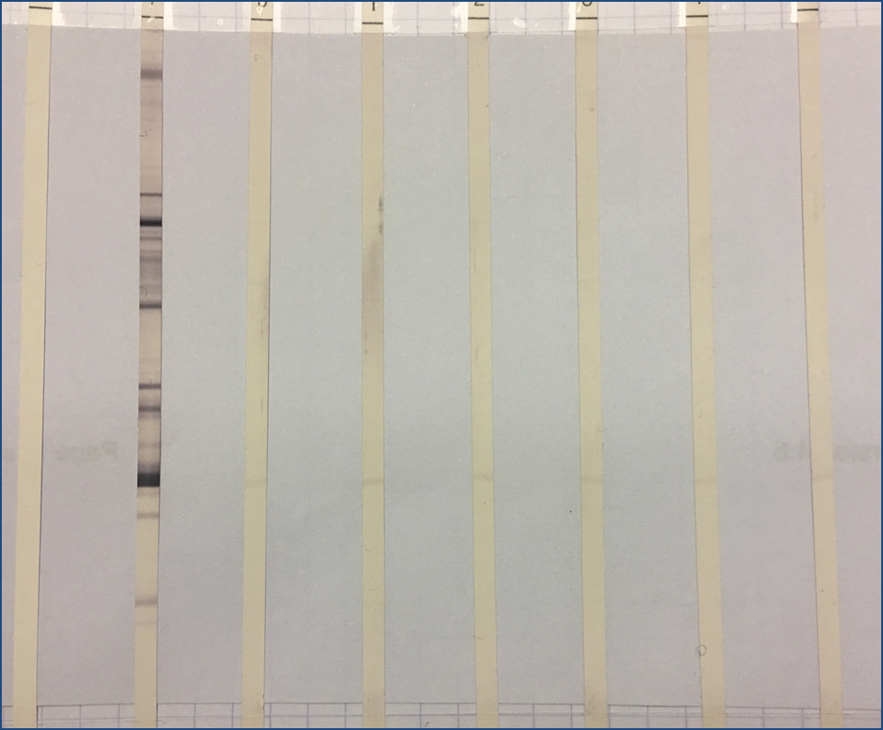
False-Positive HIV 4G-EIA in a PrEP User ?
Neg. Control
Pos. Control
June
5
June
11
June
15
July
4
October
18
January
23
Participant used on demand PrEP with TDF/FTC since January 2016, high adherence
Always HIV negative by 4G-EIA, last negative test in March 2018 (Liaison XL Murex)
June 2nd 2018, tested at another lab: 4G EIA Elecsys® HIV Duo positive, WB negative
Dates | PreP | TFV ng/ml | 4G-EIA Index Architect | 4G-EIA Bioplex | WB Ab | HIV RNA Roche
06/05/18 | ON | 52.8 | 1.58 | NEG | p24 | < 20 c/mL
Supervised Interruption of PrEP
06/11/18 | OFF d6 | 1.36 | 1.49 | NEG | p24 | < 20 c/mL
06/15/18 | OFF d10 | < 1 | 1.56 | NEG | p24 | < 20 c/mL
07/04/18 | OFF d30 | < 1 | 1.76 | NEG | p24 | < 20 c/mL
False reactivity of ARCHITECT test, PrEP could be re-introduced
10/18/18 | OFF M4 | < 1 | 1.38 | NEG | p24 | < 20 c/mL
01/23/19 | OFF M7 | < 1 | 1.82 | NEG | p24 | < 20 c/mL
p24

Slide 21
How to Manage Ambiguous HIV Test Results during PrEP
Subject on PrEP
Quarterly screening
More experience needed to manage ambiguous tests results
To resove false-positive results:
Repeat testing, discussion between clinicians and virologists
Seek expert opinion
PrEPline toll-free 855-448-7737 (11 am – 6 pm EST)
Ambiguous HIV Tests
Confirm the presence or absence of infection:
  Repeat serologic tests, RNA tests (DNA tests not yet validated)
  Use tests from another manufacturer
Manage antiretroviral drugs and resume condoms use
Continue PrEP
if PrEP adherence
Stop PrEP
Reassess HIV status
Initiate ART
if no PrEP adherence
Maintains protection
Risk for resistance
Facilitate diagnosis Risk of infection
Drug-related AEs
Confirm diagnosis
Smith DK et al OFID 2018; Stekler JD et al. OFID 2018; Saag M et al. IAS-USA 2018 guidelines JAMA 2018
Notes:
Use of PrEP has markedly increased over the past 5 years, and with quartely HIV screening, there will be more false-positive and false-negative tests occurring
Aslo, use of PrEP at the time of infection may alter the dynamics of viremia, and patient’s immune response in ways that can affect current algorithms for HIV diagnosis
Accurate and quick resolution of ambiguous test results enables timely and proper management, and minimize potential harm such as ART-resistance and psychological stress

Slide 22
Treatment of HIV Infection on PrEP
Difficult situation to handle
Expert opinion
  - Start ART immediately with a regimen with high barrier to resistance
  - TDF or TAF/FTC (or AZT/3TC) as the backbone
  - Boosted Darunavir/Lopinavir or Dolutegravir/Bictegravir (unless pregnancy of childbearing potential)
  - Simplify regimen when resistance genotype available
  - Reinforce adherence to ART
DHHS 2019 guidelines

Slide 23
Summary
PrEP with oral TDF/FTC is very effective when taken
Rule out acute HIV-infection before starting PrEP
Repeat HIV tests at 1 month and every 3 months
Rare true biomedical failures but most feared
Thorough investigation of biomedical failures
Manage false-positive HIV tests

Slide 24











Acknowledgments
@jmmolinaparis
Notes:
24
24

Slide 26
Time to Virologic Rebound after ART Interruption in Persons Treated during Fiebig I Acute HIV Infection
8 Pts (7 men, 1 woman)
Treated during Fiebig 1
Median ART: 2.8 years
All rebounded > 20 c/ml
Median time : 26 days
Range: 13 to 48 days
Colby DJ et al RV411 study group Nat Medicine 2018

Slide 27
Positive HIV Test Results in a PrEP User
34-y man, PrEP > 1y, tested neg. with GS HIV Combo Ag/Ab EIA (Bio-Rad), excellent adherence
Enters a study to evaluate performance of POC tests while remaining on PrEP
Determine HIV-1/2 Combo (Alere): p24 Ag pos., Ab neg., acute HIV-infection ?
Days from first pos. test | Determine HIV1/2 Ag/Ab Combo | Instrumented Ag/Ab test (Architect, Bio-Rad GS) | HIV Ab POC Tests | Geenius HIV1/2 suppl. assay | HIV-1 Viral Load c/ml
0 | Ag pos., Ab neg. | Neg. | Neg. | Neg. | TND*
12 | Ag pos., Ab neg. | Neg. | Neg. | Neg. | TND
16 | Ag pos., Ab neg. | Neg. | Neg. | Neg. | TND
21 | Ag pos., Ab neg. | Neg. | Neg. | Neg. HIV-2 indeterminate | TND
29 | Ag pos., Ab neg. | Neg. | Neg. | Neg. | TND
36 | Ag pos., Ab neg. | Neg. | Neg. | Neg. HIV-2 indeterminate | TND
52 | Ag pos., Ab neg. | Neg. | Neg. | Neg. HIV-2 indeterminate | TND
57 | Ag pos., Ab neg. | Neg. | Neg. | Neg. HIV-2 indeterminate | TND
70 | Ag pos., Ab neg. | Neg. | Neg. | Neg. | TND
* Target not detected
Stekler JD et al. OFID 2018
Notes:
The expansion of PrEP will likely result in a greater number of false-positive HIV tests

Slide 28
PrEP Failures in BMSM
EleMENt study: 300 young BMSM in Atlanta (16-29 years) offered PrEP free of charge
52.5% attended a PrEP initiation visit and were given a prescription
14 incident HIV diagnoses (6.2% annually)
  - 5 expressed no interest in PrEP (F, H)
  - 5 expressed interest but failed to start PrEP (E, G)
  - 4 who started PrEP became infected:
  1 with low PrEP adherence (B)
  2 discontinued PrEP (C, D)
  1 diagnosed at the first post-initiation visit: Acute HIV-infection at PrEP initiation? (A)
It is critical to monitor PrEP users every 3 months
to reinforce PrEP adherence and detect early HIV-infection
0
3
6
9
12
Serota DP et al. CID 2018
Time, months
Notes:
NC: North Carolina

Slide 29
PrEP Failures in BMSM
EleMENt study: 300 young BMSM in Atlanta (16-29 years) offered PrEP free of charge
52.5% attended a PrEP initiation visit and were given a prescription
14 incident HIV diagnoses (6.2% annually)
  - 5 expressed no interest in PrEP (F, H)
  - 5 expressed interest but failed to start PrEP (E, G)
  - 4 who started PrEP became infected:
  1 with low PrEP adherence (B)
  2 discontinued PrEP (C, D)
  1 diagnosed at the first post-initiation visit: acute HIV-infection at PrEP initiation? (A)
0
3
6
9
12
Serota DP et al. CID 2018
Time, months
Notes:
NC: North Carolina

Slide 30
Performance of an HIV Ag/Ab Combined Assay to Detect Acute HIV Infection
74,334 pts screened for HIV
HIV Prevalence: 10.9%
Screened for Acute HIV Infection
HIV Ag/Ag Combination Assay
+
-
81 Reactive Ag/Ab Combined assays
Pooled HIV RNA:
31 positive detected
89 reactive Ag/Ab
2-5 days later
Median viral load:
2482 c/ml (82-84,545)
28% acute HIV infections missed !
De Souza et al. AIDS 2015
Notes:
Thai red cross AIDS research center in Thailand is anonymous VCT center
RV254/SEARCH 010 study to offer immediate ART to AHI

